Slide 1
CMSC201
Computer Science I for Majors
Lecture 06 – While Loops

Slide 2
Last Class We Covered
Algorithms
Program design
  Input, process, output
  Flowcharts and pseudocode
Decision structure practice

Slide 3
Any Questions from Last Time?

Slide 4
Today’s Objectives
To learn about and use a while loop
  To understand the syntax of a while loop
  To use a while loop for interactive loops
To practice conditionals

Slide 5

Announcement: BRAID Survey
Based on your enrollment in this course, you will be receiving an email inviting you to take a short survey about your experiences in computer science. I strongly encourage you to participate in this survey, since your participation is vital to understanding the diverse experiences of computer science students.
The first 400 respondents to complete the survey across the BRAID campuses will receive a $15 Amazon gift card as compensation and all students who complete the survey will be entered in a drawing to win one of two $125 Amazon gift cards.
Please watch for an email with a link to complete the survey.

Slide 6
Practice: if, elif, and else
if
else
elif
if
elif
elif
else
else
if
elif
if
elif
if
if
elif
else
if
else
if
elif
elif
else
if
if
if
else
if
if
elif

Slide 7
Practice: if, elif, and else
✗
✗
✓
if
else
elif
if
elif
elif
else
else
if
elif
if
elif
✓
if
if
elif
else
✗
if
else
if
elif
elif
else
✓
if
if
if
else
if
✓
if
elif

Slide 8
Practice: if, elif, and else
✗
✗
✓
if
else
elif
if
elif
elif
else
else
if
elif
if
elif
✓
if
if
elif
else
✗
if
else
if
elif
elif
else
✓
if
if
if
else
if
✓
if
elif

Slide 9
Looping

Slide 10
Control Structures
Structures that control how the program “flows” or operates, and in what order
Sequence
Decision Making
Looping
✓
we’ve already seen these
✓
what we’re covering today

Slide 11
Looping
Doing something over and over (and over) again
Used in combination with decision making
  Otherwise we loop forever
    This is called an “infinite loop”
What are some real life examples?
  Jumping rope
  Walking up steps

Slide 12
Looping
We’ll cover this in detail today
It looks
something
like this…
expression
True
statement
False

Slide 13
Looping
Python has two kinds of loops, and they are used for two different purposes
The while loop
  Works for basically everything
The for loop:
  Best at iterating over a list
  Best at counted iterations
what we’re covering today

Slide 14
The while Loop

Slide 15
“while” Loops
while <condition>:
<body>
The body is a sequence of one or more statements indented under the heading
  As long as the condition is True, the body will run (repeatedly if needed)

Slide 16
How a while Loop Works
The while loop requires a Boolean condition
  That evaluates to either True or False
If the condition is True:
  Body of while loop is executed
  Condition is checked again
If the condition is False:
  Body of while loop is skipped

Slide 17
Parts of a while Loop
Here’s some example code… let’s break it down
  date = 0
  while date < 1 or date > 28:
  date = int(input("Enter the day: "))
  print("Today is February", date)

Slide 18
Parts of a while Loop
Here’s some example code… let’s break it down
  date = 0
  while date < 1 or date > 28:
  date = int(input("Enter the day: "))
  print("Today is February", date)
initialize the variable the while loop will use for its decision
the loop’s Boolean condition (loop runs until this is False)
the body of the loop
(must change the value of the loop variable)

Slide 19
Example while Loop
We can use a while loop to count
  Count from 1 up to and including 20
  num = 1 # we have to initialize num
  while num <= 20: # so that we can use it here
  print(num)
  num = num + 1 # don't forget to update
  # the loop variable

Slide 20
Example while Loop
Start
num = 1
while
num <= 20
TRUE
Display num
num = num + 1
FALSE
End

Slide 21
Infinite Loops and Other Problems

Slide 22

Infinite Loops
An infinite loop is a loop that will run forever
  The conditional the loop is based on always evaluates to True, and never to False
Why might this happen?
  The loop variable is not updated
  The loop variable is updated wrong
  The loop conditional uses the wrong variable
  The loop conditional checks the wrong thing
Image from wikimedia.org
Notes:
https://commons.wikimedia.org/wiki/File:Flat_UI_-_infinity.png

Slide 23
Infinite Loop Example #1
Why doesn’t this loop end? What will fix it?
  age = 0
  while age < 18: # can't vote until 18
  print("You can't vote at age", age)
  print("Now you can vote! Yay!")

Slide 24
Infinite Loop Example #1
Why doesn’t this loop end? What will fix it?
  age = 0
  while age < 18: # can't vote until 18
  print("You can't vote at age", age)
  print("Now you can vote! Yay!")
the loop variable (age) never changes, so the condition will never evaluate to False

Slide 25
Infinite Loop Example #2
Why doesn’t this loop end? What will fix it?
  while True:
  # ask user for name
  name = input("What is your name? ")
  print("Hello", name + "!")

Slide 26
Infinite Loop Example #2
Why doesn’t this loop end? What will fix it?
  while True:
  # ask user for name
  name = input("What is your name? ")
  print("Hello", name + "!")
True will never evaluate to False, so the loop will never exit

Slide 27
Infinite Loop Example #3
Why doesn’t this loop end? What will fix it?
  cookiesLeft = 50
  while cookiesLeft > 0:
  # eat a cookie
  cookiesLeft = cookiesLeft + 1
  print("No more cookies!")

Slide 28
Infinite Loop Example #3
Why doesn’t this loop end? What will fix it?
  cookiesLeft = 50
  while cookiesLeft > 0:
  # eat a cookie
  cookiesLeft = cookiesLeft + 1
  print("No more cookies!")
the loop body is INCREASING the number of cookies, so we’ll never reach zero!

Slide 29
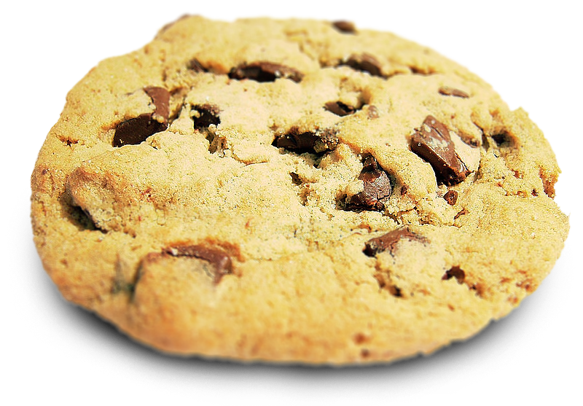
Infinite Loop Example #3
Why doesn’t this loop end? What will fix it?
  cookiesLeft = 50
  while cookiesLeft > 0:
  # eat a cookie
  cookiesLeft = cookiesLeft + 1
  print("No more cookies!")
the loop body is INCREASING the number of cookies, so we’ll never reach zero!
Image from wikimedia.org
Notes:
https://en.wikipedia.org/wiki/File:Choco_chip_cookie.png

Slide 30
Infinite Loop Example #4
Why doesn’t this loop end? What will fix it?
  grade = ""
  name = ""
  while name != "Hrabowski":
  # get the user's grade
  grade = input("What is your grade? ")
  print("You passed!")

Slide 31
Infinite Loop Example #4
Why doesn’t this loop end? What will fix it?
  grade = ""
  name = ""
  while name != "Hrabowski":
  # get the user's grade
  grade = input("What is your grade? ")
  print("You passed!")
the loop conditional is checking the wrong thing! we also never change the name, so this will never end

Slide 32
Ending an Infinite Loop
If you run a program that contains an infinite loop, it may seem like you’ve lost control of the terminal!
To regain control, simply type CTRL+C to interrupt the infinite loop
  KeyboardInterrupt

Slide 33
Loop Body Not Being Reached
A while loop’s body may be skipped over entirely
  If the Boolean condition is initially False
militaryTime = 1300
while (militaryTime < 1200):
print("Good morning!")
militaryTime = militaryTime + 100

Slide 34
Practice with Decisions

Slide 35
Loop Example #4 – Fixing It
Let’s update this to ask for the user’s grade
  An “A” or a “B” means that they passed
  grade = ""
  while ...what goes here?
  # get the user's grade
  grade = input("What is your grade? ")
  print("You passed!")

Slide 36
Loop Example #4 – Truth Table
Let’s evaluate this expression
  grade != "A" or grade != "B"
grade | grade != "A" | grade != "B" | or
"A" | False | True | True
"B" | True | False | True
"C" | True | True | True

Slide 37
Loop Example #4 – Truth Table
Let’s evaluate this expression
  grade != "A" or grade != "B"
This does not give us the answer we want
  This just loops forever and ever (infinitely)
grade | grade != "A" | grade != "B" | or
"A" | False | True | True
"B" | True | False | True
"C" | True | True | True

Slide 38
Loop Example #4 – Truth Table
Let’s try it with an and instead of an or
  grade != "A" and grade != "B"
grade | grade != "A" | grade != "B" | and
"A" | False | True | False
"B" | True | False | False
"C" | True | True | True

Slide 39
Loop Example #4 – Truth Table
Let’s try it with an and instead of an or
  grade != "A" and grade != "B"
Now our program will behave how we want
  You will sometimes have to stop and make a table!
grade | grade != "A" | grade != "B" | and
"A" | False | True | False
"B" | True | False | False
"C" | True | True | True

Slide 40
Loop Example #4 – Completed
Let’s update this to ask for the user’s grade
  An “A” or a “B” means that they passed
  grade = ""
  while grade != "A" and grade != "B":
  # get the user's grade
  grade = input("What is your grade? ")
  print("You passed!")

Slide 41
Interactive while Loops

Slide 42
When to Use while Loops
while loops are very helpful when
you want to get input from the user
that meets certain specific conditions
  Positive number
  A non-empty string
  A number within a certain range

Slide 43
Example while Loop
We can use a while loop to get correct input from the user by re-prompting them
    num = 0 # we have to initialize num
    while num <= 0: # so that we can use it here
    num = int(input("Enter a positive number: "))
    # while loop exits because num is positive
    print("Thank you. The number you chose is:", num)

Slide 44
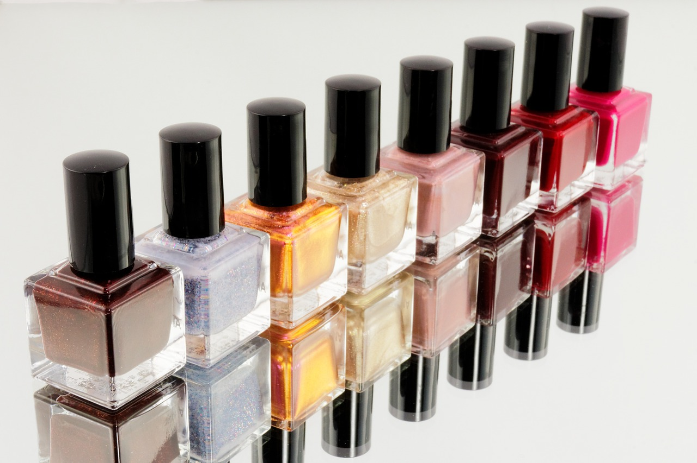
Updated Exercise: Nail Polish
Update your nail polish “guessing game” to keep re-prompting the user until they guess the right number of bottles
At each step, tell them whether
their guess was high or low
Exit the loop when they
guess correctly
Image from pixabay.com
Notes:
https://pixabay.com/en/manicure-pedicure-cosmetics-870857/

Slide 45
Announcements
HW 2 is out on Blackboard now
  Complete the Academic Integrity Quiz to see it
  Due by Friday (Feb 17th) at 8:59:59 PM
Make sure to spell the dog breeds correctly!
  Will make it much easier for your TA to grade
Pre Lab 4 Quiz will come out Friday @ 10 AM
  Must be completed by 9 AM Monday morning

